Slide 1

Learning Objective
I will expand binomials
Enter quietly, please be ready with the following on your desk:
Whiteboard
Whiteboard marker
Exercise Book
Pencil, pen, ruler and red pen
Diary
Calculator
Device – charged or borrowed from Library before maths

Slide 2
Daily Review
$$4 (a+6)$$
$$4 lots of (a+6)$$
$$a$$
$$6$$
$$4 (a+6)$$
$$=4a+24$$
$$4$$
$$4a$$
$$24$$

Slide 3
Daily Review
$$5 (a−2)$$
$$5 lots of (a−2)$$
$$a$$
$$−2$$
$$5 (a−2)$$
$$=5a−10$$
$$5$$
$$5a$$
$$−10$$

Slide 4
Daily Review
$$2c (a+3b)$$
$$2c lots of (a+3b)$$
$$a$$
$$3b$$
$$2c (a+3b)$$
$$2c$$
$$2ac$$
$$6bc$$
$$=2ac+6bc$$

Slide 5
Daily Review
$$3 \left(r−4\right)−8r$$
$$3 lots of \left(r−4\right), then take away 8r$$
$$r$$
$$−4$$
$$3 \left(r−4\right)−8r$$
$$=3r −12 −8r$$
$$3$$
$$3r$$
$$−12$$
$$=−5r −12$$

Slide 6
Daily Review
$$5\left(a+6b\right)+a(9 −10a)$$
$$a$$
$$6b$$
$$5\left(a+6b\right)+a(9 −10a)$$
$$9$$
$$−10a$$
$$5$$
$$5a$$
$$30b$$
$$=5a+30b+a(9 −10a)$$
$$a$$
$$9a$$
$$−10a2$$
$=5a+30b+9a−10a$²
$$5a+30b$$
$$9a−10a2$$
$=14a+30b−10a$²

Slide 7
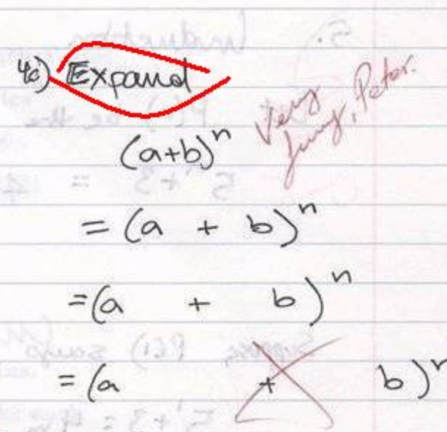
Learning Objective
CFU
What will we learn today?
CFU
I will expand binomials.
How will you know that you are successful?
Success Criteria
At the end of the lesson, I will be able to:
Expand algebraic expressions by multiplying out the brackets using the array method.

Slide 8
Activate Prior Knowledge
VOCABULARY
Multiply – groups of, lots of, product, times, per, of, by
Distributive law – we split large numbers into 1s, 10s and 100s
= (20 x 40) + (20 x 3)
+ (6 x 40) + (6 x 3)
= (6 x 50) + (6 x 3)
26 x 43
6 x 53
50
3
40
3
0
30
18
+ 18
8
6
0
00
30
6
8
0
20
00
318
24
0
6
0
24
+ 18
6
0
18
1118

Slide 9





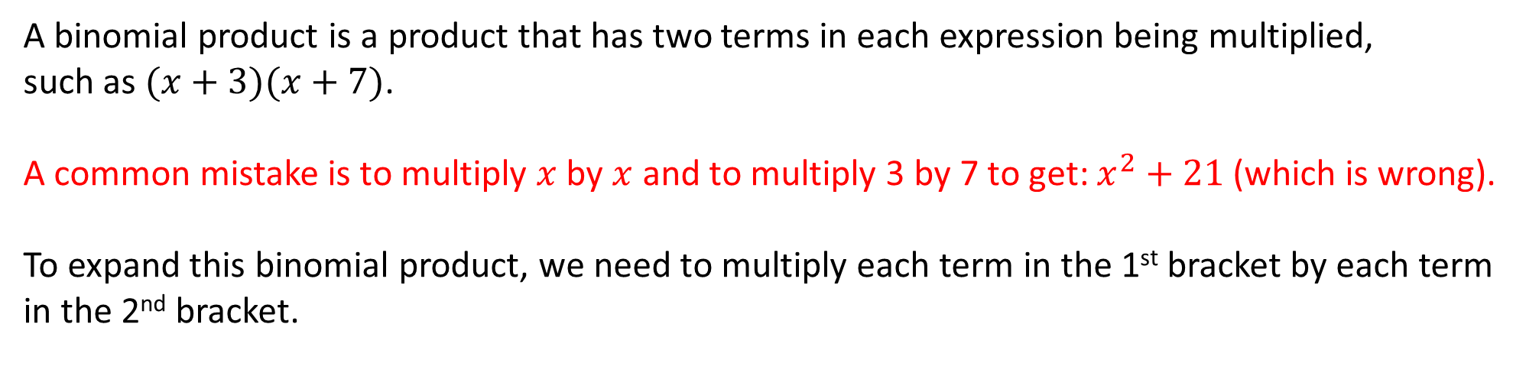






Concept Development
CFU 1
Can we simplify it at all?
A binomial product is a product that has two terms in each expression being multiplied,
such as $(x+3)(x+7)$.
A common mistake is to multiply $x$ by $x$ and to multiply 3 by 7 to get: $x^{2}+21$ (which is wrong).
To expand this binomial product, we need to multiply each term in the 1st bracket by each term in the 2nd bracket.
$$x$$
$$7$$
$$(x+3)(x+7)$$
$$x$$
$$x^{2}$$
$$7x$$
$$=x^{2}+3x+7x+21$$
$$3$$
$$3x$$
$$21$$
$$=x^{2}+10x+21$$

Slide 10





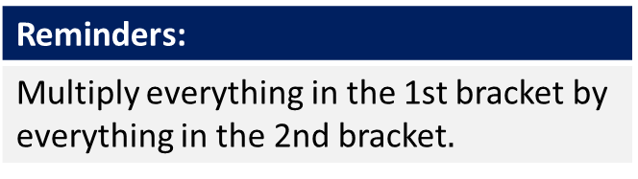






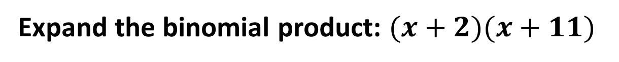
Skill Development/Guided Practice
Reminders:
Multiply everything in the 1st bracket by everything in the 2nd bracket$.$
Expand the binomial product: $(x+2)(x+11)$
$$x$$
$$11$$
$$(x+2)(x+11)$$
$$x$$
$$x^{2}$$
$$11x$$
$$=x^{2}+2x+11x+22$$
$$2$$
$$2x$$
$$22$$
$$=x^{2}+13x+22$$

Slide 11








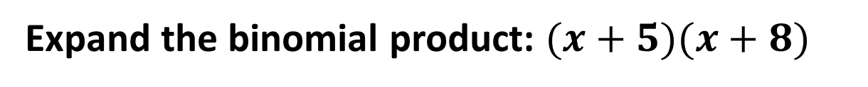
Skill Development/Guided Practice
Reminders:
Multiply everything in the 1st bracket by everything in the 2nd bracket$.$
Expand the binomial product: $(x+5)(x+8)$
$$x$$
$$8$$
$$(x+5)(x+8)$$
$$x$$
$$x^{2}$$
$$8x$$
$$=x^{2}+5x+8x+40$$
$$5$$
$$5x$$
$$40$$
$$=x^{2}+13x+40$$

Slide 12






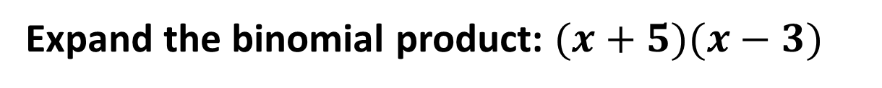
Skill Development/Guided Practice
Reminders:
Multiply everything in the 1st bracket by everything in the 2nd bracket$.$
Expand the binomial product: $(x+5)(x−3)$
$$x$$
$$−3$$
$$(x+5)(x−3)$$
$$x$$
$$x^{2}$$
$$−3x$$
$$=x^{2}+5x−3x−15$$
$$5$$
$$5x$$
$$−15$$
$$=x^{2}+2x−15$$

Slide 13








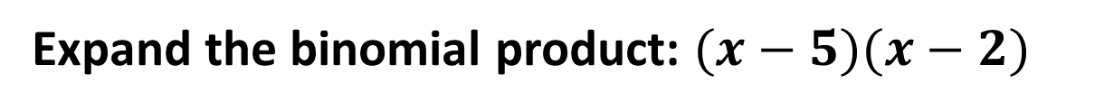
Skill Development/Guided Practice
Reminders:
Multiply everything in the 1st bracket by everything in the 2nd bracket$.$
Expand the binomial product: $(x−5)(x−2)$
$$x$$
$$−2$$
$$(x−5)(x−2)$$
$$x$$
$$x^{2}$$
$$−2x$$
$$=x^{2}−5x−2x+10$$
$$−5$$
$$−5x$$
$$10$$
$$=x^{2}−7x+10$$

Slide 14











Skill Development/Guided Practice
Reminders:
Multiply everything in the 1st bracket by everything in the 2nd bracket$.$
Expand the binomial product: $(3x−1)(2x−5)$
$$2x$$
$$−5$$
$$(3x−1)(2x−5)$$
$$3x$$
$${6x}^{2}$$
$$−15x$$
$$={6x}^{2}−15x−2x+5$$
$$−1$$
$$−2x$$
$$5$$
$$={6x}^{2}−17x+5$$

Slide 15
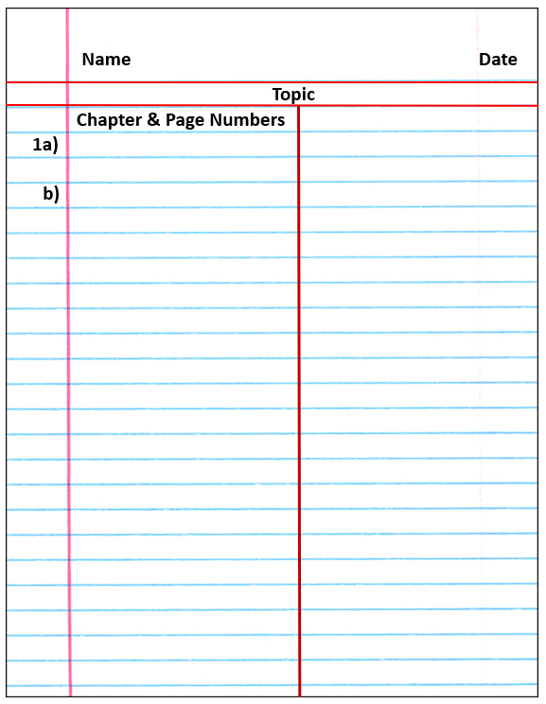
Independent Practice
Mathematics Page Layout
Pearson 10 – Ex 3.1 page 154 Question 2
Mathspace task – Year 10 Mainstream Expanding Brackets CLASSWORK

